Slide 1
Ohio Constitutional Modernization Commission
Presentation on Redistricting
Paul A. Beck, The Ohio State University
July 10, 2013

Slide 2
Introduction
Design of legislative districts has been contentious issue since beginnings of democratic politics, as partisans vie for extra advantage thru gerrymandering (see slide #3 for original Gerry-mander)
Ohio has long history of gerrymandering
1851 Ohio Constitution was changed to reduce gerrymandering frenzy by taking it out of the hands of the legislature, at least for the General Assembly
From 1870-1900, the state legislature redistricted congressional districts 8 times, each time partisan control of the legislature changed (see slide #4 for details)
  New district lines emphasized competitiveness over incumbent protection
  Close to 2/3rds of the districts were competitive in the 45-55% range, and in every election year but one, at least half of the districts were that competitive
Commission has opportunity to serve Ohioans by making redistricting fairer and less partisan in future
The goal is to create a democratic “institution” for redistricting that will endure
I appreciate opportunity to help frame your thinking about how to do it

Slide 3
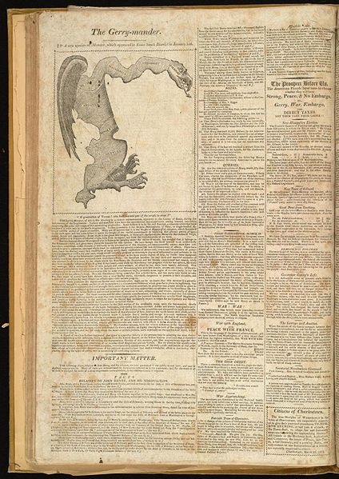
Gerry’s “Salamander”

Slide 4
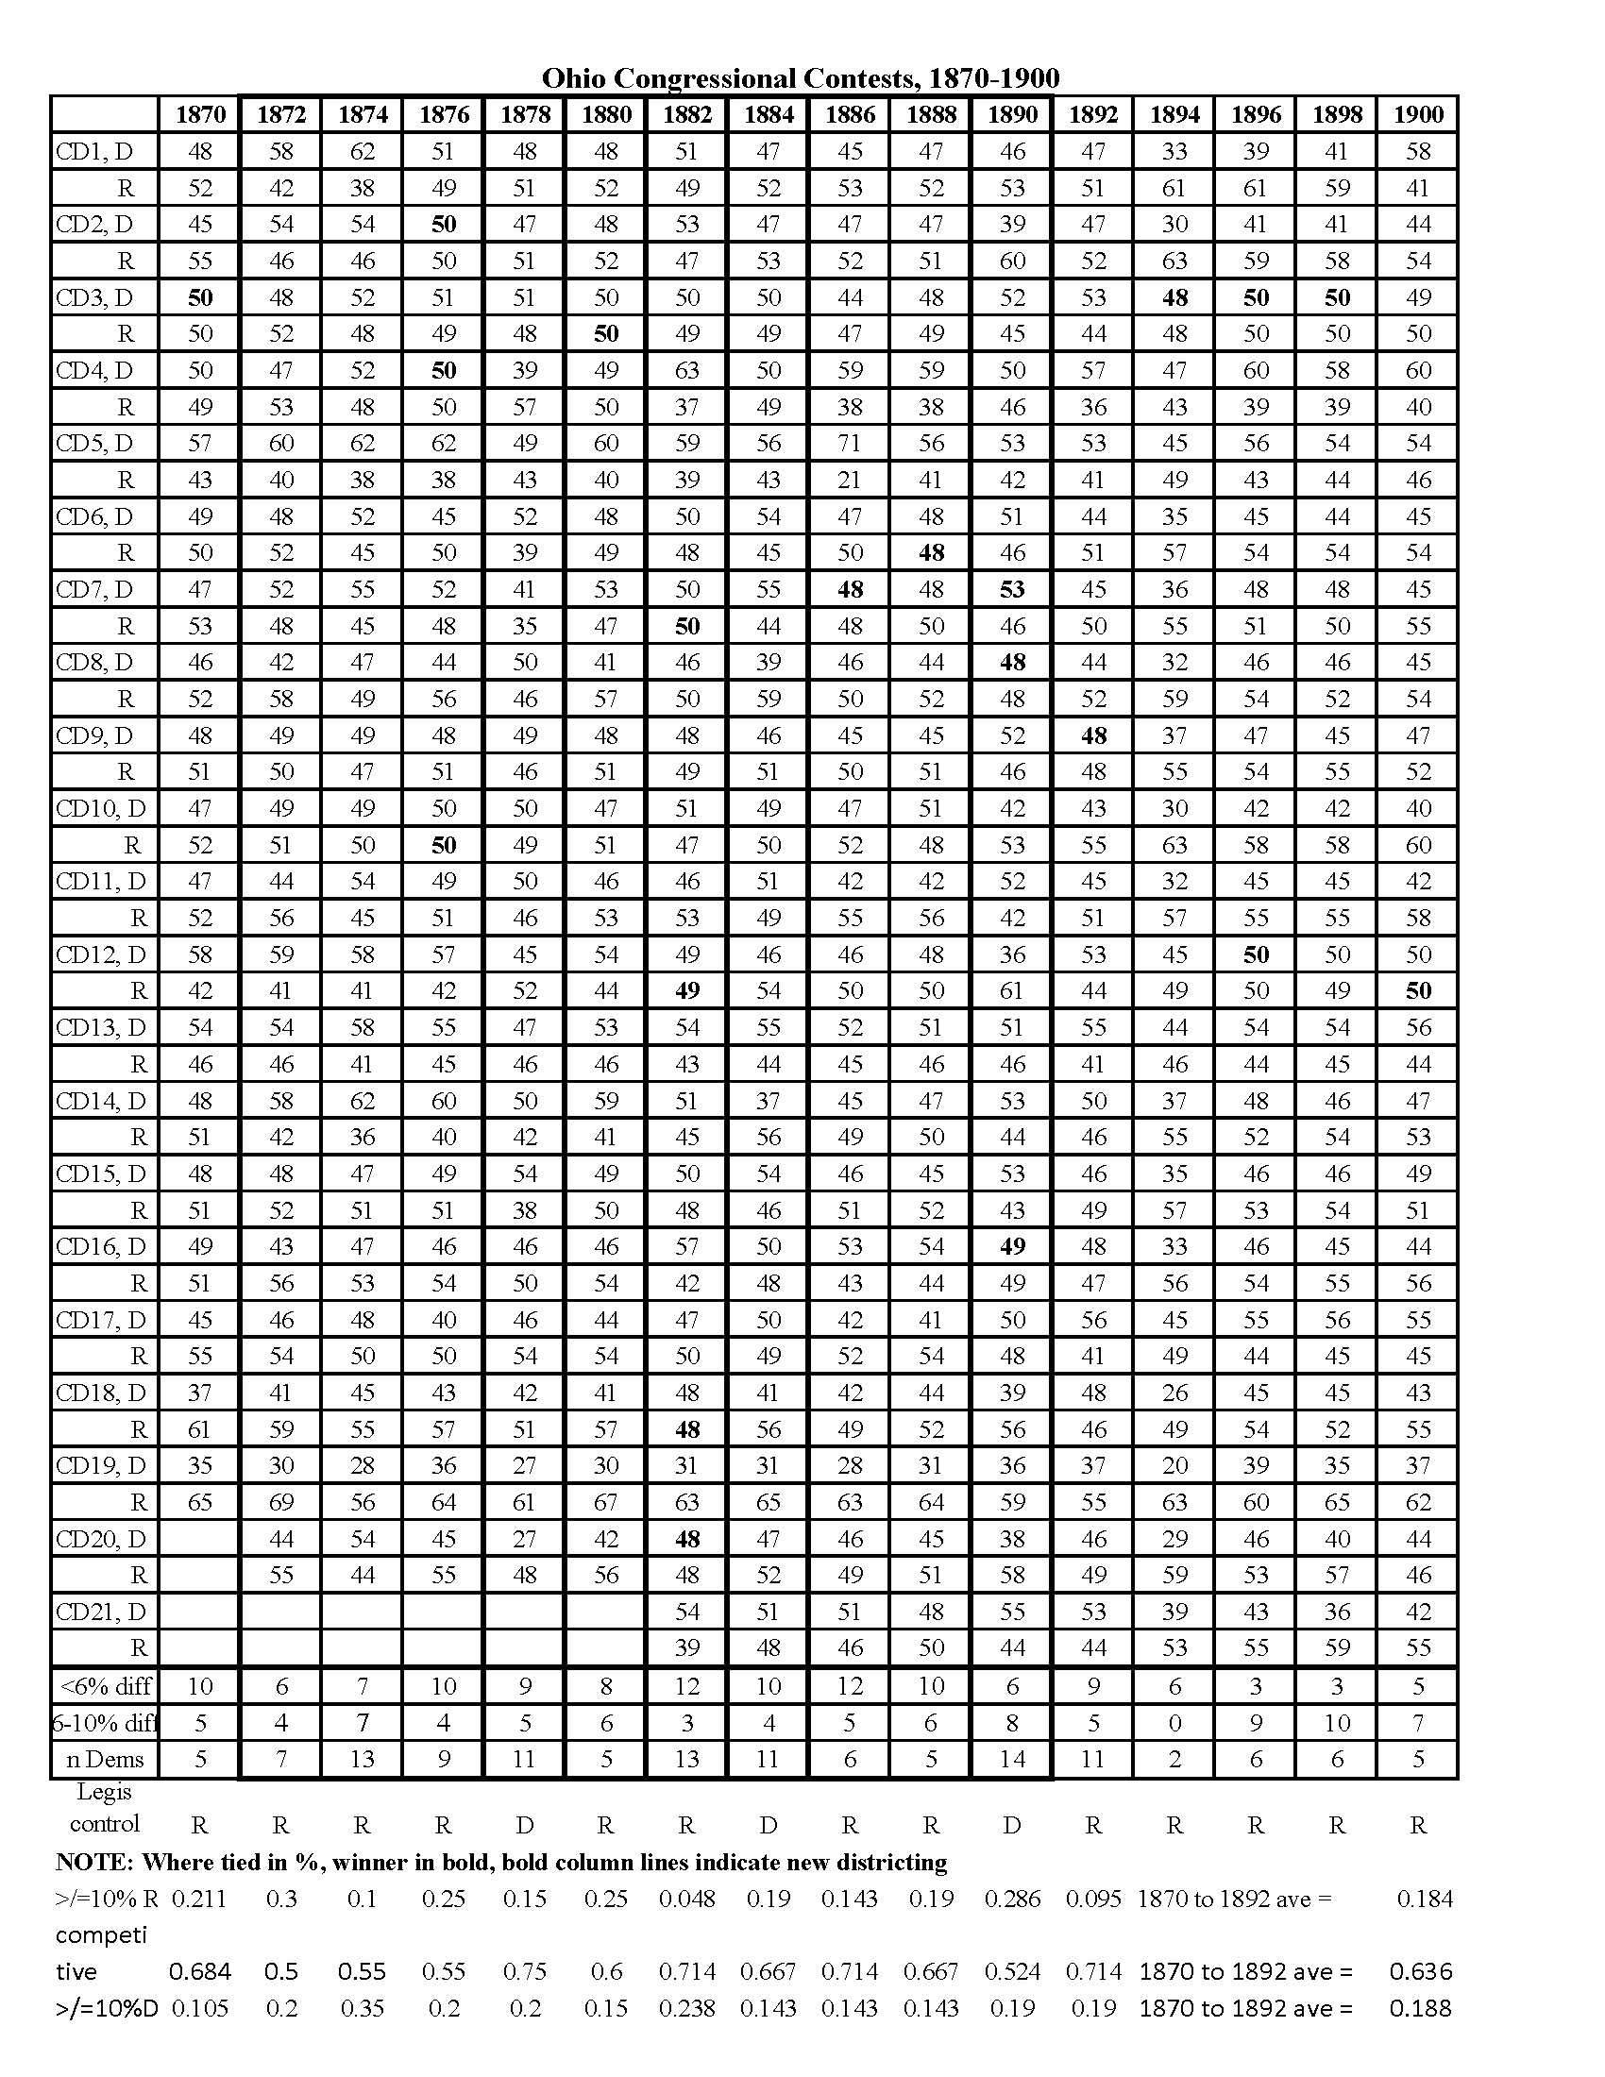
Ohio Redistricting, 1870-1900

Slide 5
3 Problems with Partisan Gerrymandering
Distorted translation of votes into seats, giving one party more representation than earned by popular votes
    Ideally parties should win # seats in direction proportion to # votes
    Modern computer technology, coupled with extensive data on political jurisdiction building blocks, enables redistricters to maximize seats for their party, or whatever else they value
    Greater the distortion, the more alienated voters become from political system – and trust has declined to dangerous levels in US
Incumbent protection: where incumbent legislators influence redistricting, they create safe seats for themselves and their party by making districts uncompetitive
Often prevents voters from having genuine choice in general election
Makes incumbents more fearful of primary than general election competition
  Drives them more to extreme of their party
  Makes them more vulnerable to independent spending in primaries, a powerful recent force
  Gives them less protection from interest group pressures – via primary challenges and inability to cite their general election constituents as consideration in voting
Destruction of political communities: creates artificial communities of voters who seem to lack any commonality with one another
These problems appear whether Republicans (MI, PA, FL) or Democrats (IL, MD) have engineered gerrymander, as both parties seek partisan advantage

Slide 6
Dissatisfactions along These Lines with Ohio’s Current Plan
    Votes to seats distortion is substantial
      In 2012, Ohio voters divided almost equally between major parties statewide
        presidential vote: 50%-48% Obama
        OH House vote: 49% Republican
        US House vote: 52% Republican
      Yet, Republicans hold huge majorities of legislative seats: 61% of OH House, 75% of US House (70% of OH Senate)
        Resulting Republican advantage attributable to highly partisan gerrymander was 23% for US House and 12% for state house
        More distorted than virtually any in democratic world and among the US states, more than in 2001 plan
    Most voters do not face competitive contests (→ incumbent protection)
      In > 3/4s of districts in 2012, winner had >10% margin: US House 87.5%; OH House 84%; OH Senate 79%
      Many contests had >30% winning margin: US House, 31%; Ohio House, 24%; Ohio Senate, 43%
    Questionable political communities: several of congressional districts (especially CD 9) seemed to defy compact, contiguity logic
    Future plan should try to avoid these problems.

Slide 7
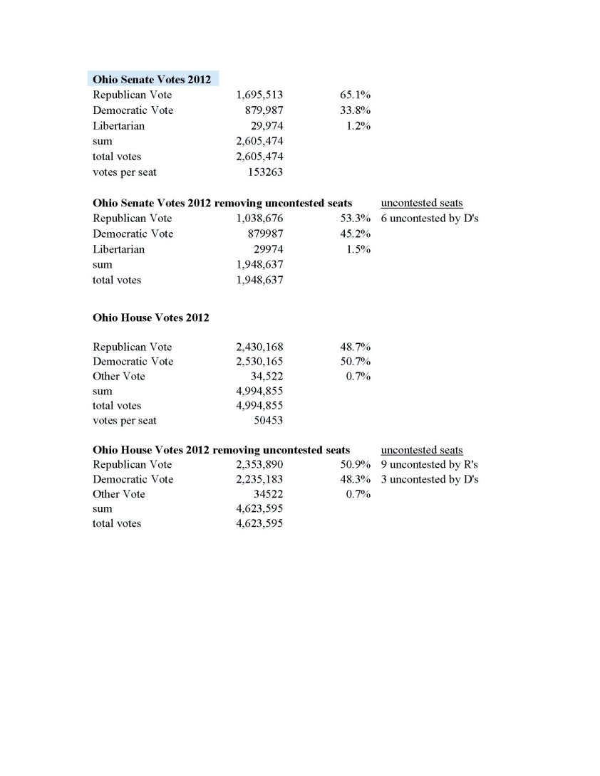
Vote Results in Ohio Contests, 2012

Slide 8
Ohio 2012 Legislative Competition
OHIO 2012 CONGRESSIONAL RESULTS (district #s)
Margin of victory over major-party opponent | Democratic winner | Republican winner | Total
<10% |  | 12.5% | 12.5%
10-20% |  | 25.0% | 25.0%
20-30% |  | 31.3% | 31.3%
30-40%
40-99% | 18.8% |  | 18.8%
100% | 6.3% | 6.3% | 12.5%
Total | 25.0% | 75.0% | 100.0%
OHIO 2012 STATE SENATE RESULTS (district #s) |  |  |  |  | OHIO 2012 STATE HOUSE RESULTS (# districts)
Margin of victory over major-party opponent | Democratic winner | Republican winner | Total |  | Margin of victory over major-party opponent | Democratic winner | Republican winner | Total
<10% | 9.1% | 12.1% | 21.2% |  | <10% | 4.0% | 12.1% | 16.2%
10-20% | 6.1% | 27.3% | 33.3% |  | 10-20% | 3.0% | 17.2% | 20.2%
20-30% | 6.1% | 15.2% | 21.2% |  | 20-30% | 7.1% | 14.1% | 21.2%
30-40% | 3.0% | 9.1% | 12.1% |  | 30-40% | 3.0% | 12.1% | 15.2%
40-99% | 12.1% |  | 12.1% |  | 40-99% | 13.1% | 4.0% | 17.2%
100% |  |  |  |  | 100% | 9.1% | 1.0% | 10.1%
 | 36.4% | 63.6% | 100.0% |  |  | 39.4% | 60.6% | 100.0%

Slide 9
Opportunities to address dissatisfactions
Widespread recognition that current plan is undesirable
Democrats of course don’t like it, but neither do independent groups and some Republicans (e.g., SJR 1 and Secretary Husted)
Received considerable criticism from press
Ohio Senate has responded by SJR1 to offer some remedies
That it is on this Commission’s agenda offers a window to try to fashion something better, and Commission should provide guidance
Consequences if nothing is done to resolve problems:
Both parties (especially Republicans) will be drawn to their ideological extremes because of dominance of safe seats
Plan will continue to be bone of contention, perhaps triggering additional ballot initiatives to overturn it
Voters dissatisfaction with limited competition and decreased legislative responsiveness to their preferences → declining legitimacy of legislature and congressional delegation
As we approach 2020 election, which will set stage for next round of redistricting, partisan contention will increase

Slide 10
My suggestions
Think about what redistricting result would be best for citizens of Ohio, then develop process and criteria designed to best achieve it thru’ an institutional design that will serve the test of time
Who develops plan?
  Minimize self interested redistricting by “insiders”
  Specialized redistricting commission is best
  Partisan or independent, or some combination?
    If partisan, must require enough bipartisan support for plan to avoid arrangement where incumbents protect seats
    If independent, must provide mechanism for selection that protects from extensive partisan influence
    However composed, getting bipartisan agreement is critical
    Need to have unattractive fall back if no agreement is reached on plan
What criteria should be used?
  Good intentions of redistricting panel not enough; must react to plans developed from clear criteria
Setting criteria/guidelines is essential
Conventional ones of compactness, contiguity, building blocks of meaningful political subdivisions (counties, cities, townships in rural areas) should apply
Will have failed citizens if more representational fairness (votes to seats) and competitiveness do not result

